Slide 1
Lesson objective
Need calculators
Title: Volume and substitution
Aim
Be able to:
Substitute into an expression
Calculate volume of cuboids
Plan:
Review perimeter
Substitution practice
Calculating volume
PBiS Focus: Achieve
- Prepared to respond

Slide 2
Who is correct? (think, pair and share)
Sally says the perimeter of this garden bed is 12m.
Ben says its 32m
Joe thinks it’s 24m
Who is correct and what did the others do wrong?
8m
4m
Perimeter is the TOTAL distance around a shape. Sally only counted the marked sides.
Ben confused it with AREA and multiplied.
Joe is correct.

Slide 3
What is the Area?
What is the total area?
What is the area of the blue section?
5m
10m

Slide 4
Daily review (I do/we do)
To evaluate an expression, we substitute (replace) the pronumeral with a given value.
E.g. If d = 7, evaluate
Whiteboards!
4d
2d + 9
20 – 3d
2d =
3d + 2 =
5d – 8 =
45 – 4d =

Slide 5
Double signs
Double signs:
Adding a negative number is the same as subtracting.
Subtracting a negative number is the same as adding.
7 – (-3) can be written as 7 + 3
12 + (-4) can be written as 12 – 4
-3 + (-2) can be written as -3 – 2

Slide 6
Daily review – Directed number.
Same signs add – different signs subtract
Rewrite the following expressions, only simplifying the double signs.
3 – (-2) = 3 + 2
5 + (-4) = 5 – 4
-4 – (-5) = -4 + 5
-6 + (-2) = -6 – 2
Exercise books!
Evaluate if a = 4 and b = -3
2a + b
14 – b
-7 + b

Slide 7

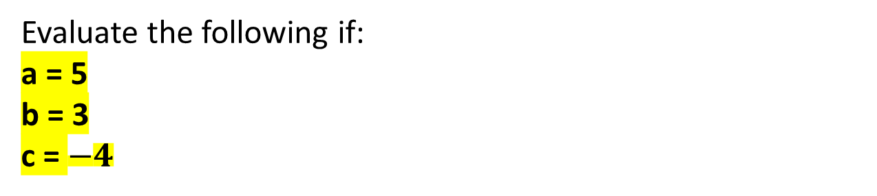
Your turn – exercise books
Evaluate the following if:
a = 5
b = 3
c = $−4$
25
12
6
11
4
3a + 4b
10b – c
2a + c
3b + a – c
9b + 5a
$20 −(−10)$
$100+(−97)$
$10 −\left(−2.5\right)$
$100+\left(−101\right)$
$27+\left(−41\right)$
30
3
12.5
-1
-14
5a
9 + b
10 + c
2 + 3b
a + b + c
27
34
6
18
52

Slide 8
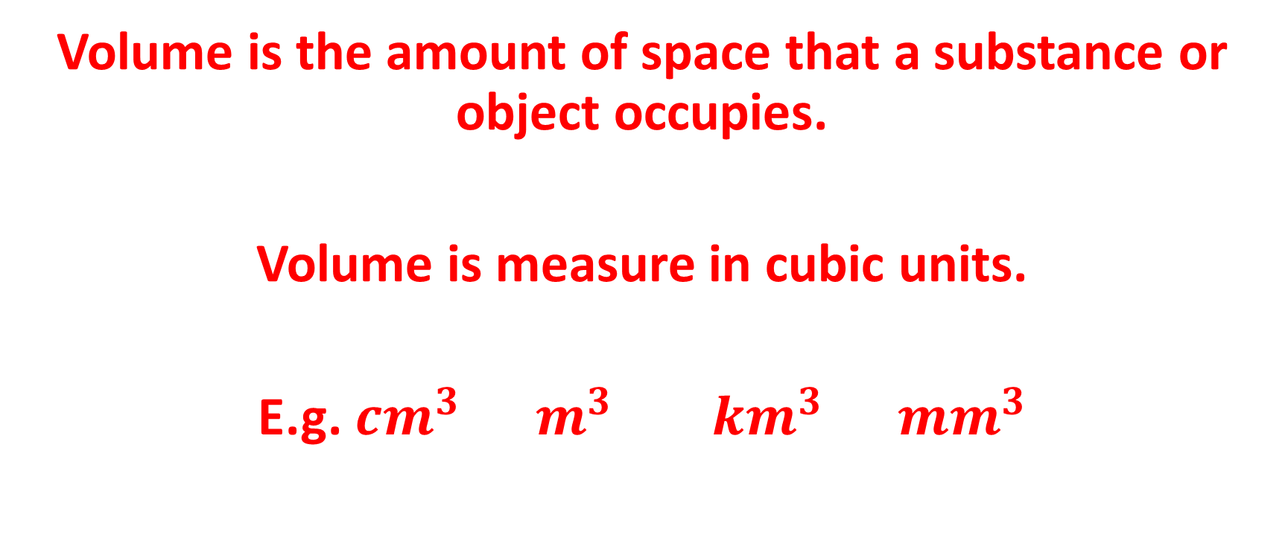
What is volume?
Volume is the amount of space that a substance or object occupies.
Volume is measure in cubic units.
E.g. $cm^{3} m^{3} km^{3} mm^{3}$

Slide 9
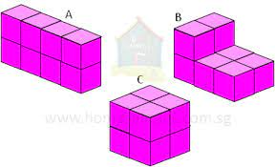
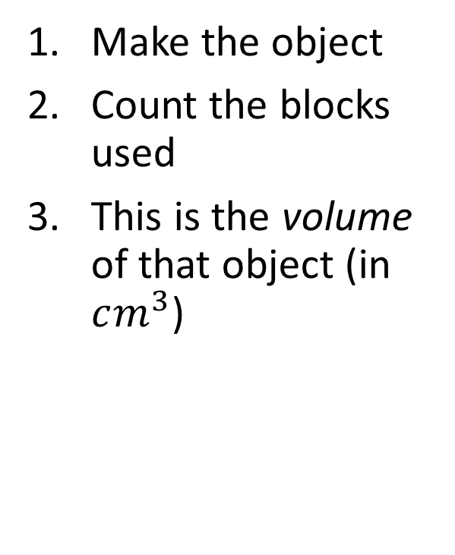
Make the shapes
Make the object
Count the blocks used
This is the volume of that object (in $cm^{3}$)

Slide 10
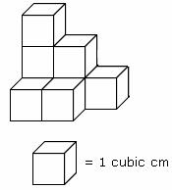
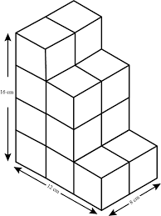
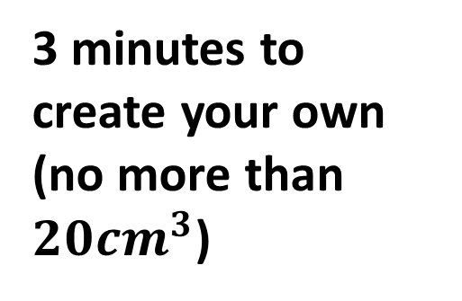
Create and count
3 minutes to create your own (no more than $20cm^{3}$)

Slide 11
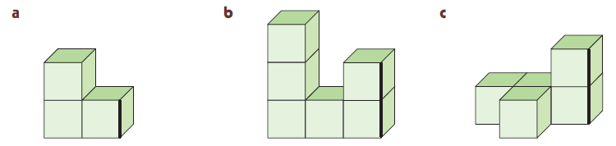
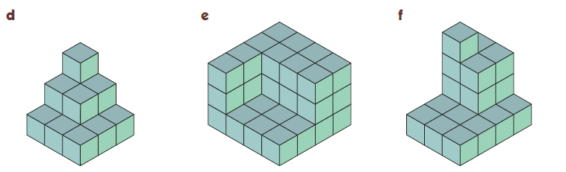
What is the volume of these shapes?
1
Count the cubes. Include ones you can’t see but that would form part of the shape
$$V=3{cm}^{3}$$
$$V=6{cm}^{3}$$
$$V=5{cm}^{3}$$
$$V=14{cm}^{3}$$
$$V=36{cm}^{3}$$
$$V=21{cm}^{3}$$

Slide 12
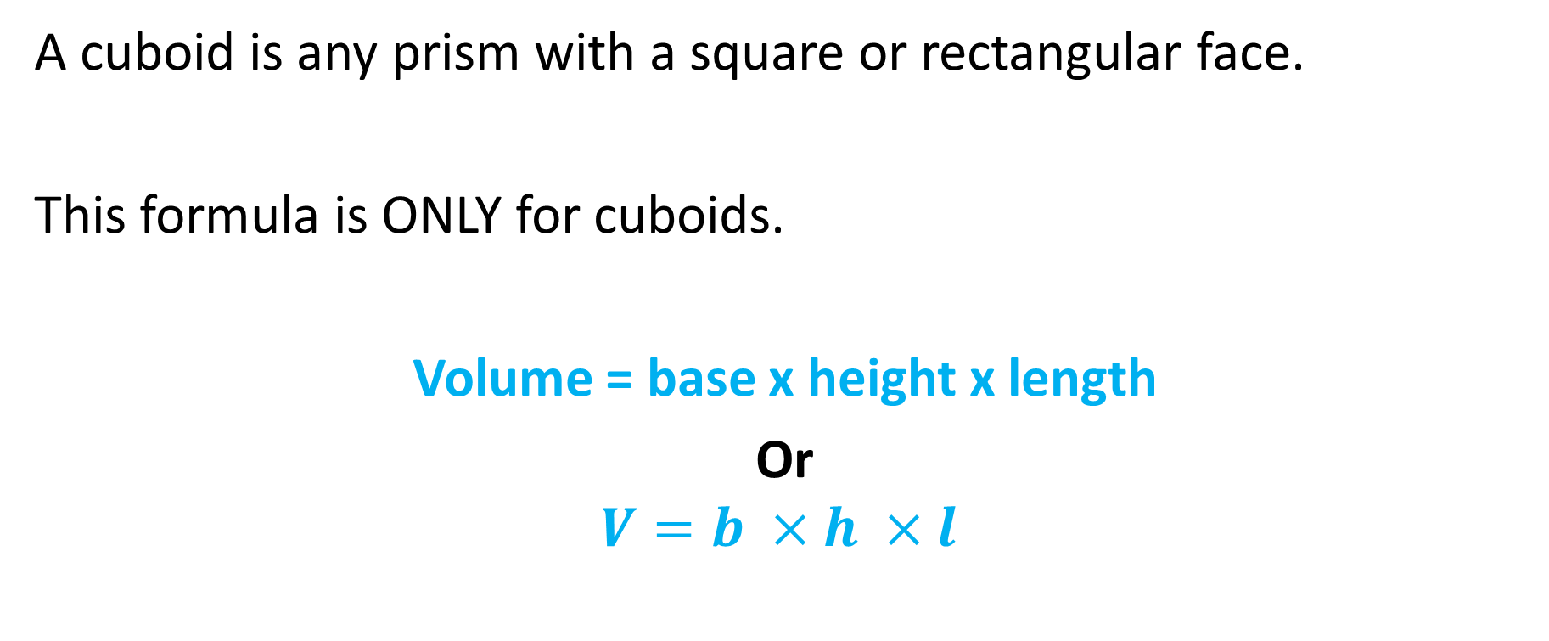
Rule for volume of cuboids
A cuboid is any prism with a square or rectangular face.
This formula is ONLY for cuboids.
Volume = base x height x length
Or
$$V=b ×h ×l$$

Slide 13
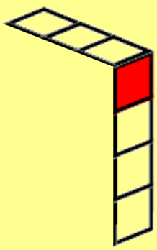
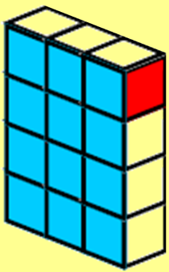
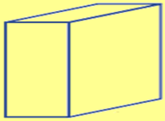

Volume of Rectangular Prisms
DIAGRAM
RULE
NUMBERS
SOLVE
1
Volume is measured in cubic units (e.g. cm³)
  Say “cubic centimetres” or “centimetres cubed”
Example: this shape’s volume is 12 cubic centimetres
    The larger shape is made of 6 shapes like the first one
    12 x 6 = 72 cubic centimetres
For any rectangular prism
$Volume=base×height×length$
1 cube = 1cm³
Write:
$$Volume=b×h×l$$
Height
$$V=3×4×6$$
Base
Length
$$V=72{cm}^{3}$$
D
$$V=b×h×l$$
R
$$V=4×3×2$$
N
$$V=24{cm}^{3}$$
S
Show 4-step working for each question

Slide 14
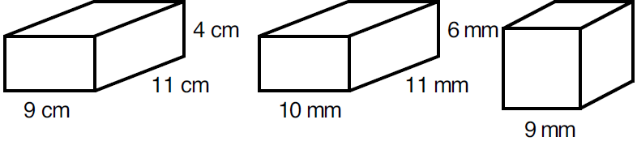
Find the volume of these rectangular prisms?
2
DIAGRAM
RULE
NUMBERS
SOLVE
$$V=b×h×l$$
$$V=9×4×11$$
$$V=396{cm}^{3}$$
$$V=b×h×l$$
$$V=10×6×11$$
$$V=660{mm}^{3}$$
Don’t times them all, just the
Base
Height
Length
$$V=b×h×l$$
$$V=9×9×9$$
$$V=729{mm}^{3}$$

Slide 15
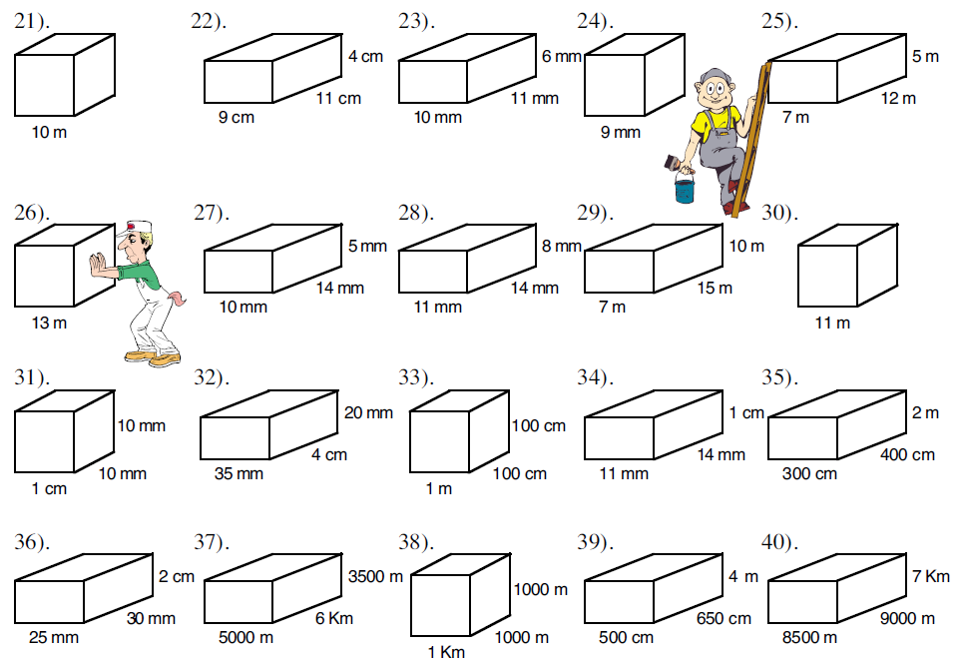
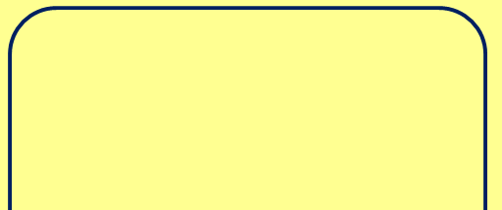
Volume Practice
DIAGRAM
RULE
NUMBERS
SOLVE
B
A

Slide 16
Area of L blocks

